Slide 1
Monthly extended DRM
April 2024
By Infra ART Lead engineers, Domain Architects, Solution consultants and System Architect
Veldhoven
Version 1.0

Slide 2
Agenda
Feedback from X-ART Architecture sync
Architecture decisions
Technical Debt
Architecture enabler Features & Stories
Solutions designs & demo’s

Slide 3
Feedback from X-ART Architecture sync

Slide 4
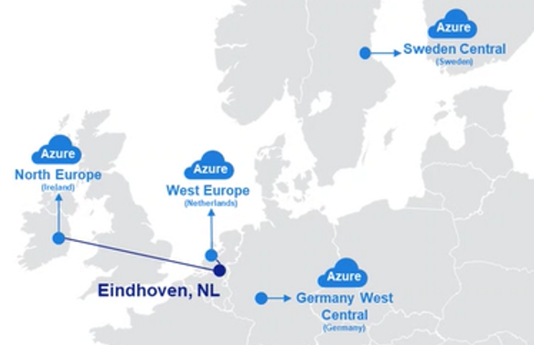
Azure EU extra Cloud region
Prepare for ASML’s future growth
Problem description
Selected solution & decisions
Azure West Europe capacity constraints
Capacity constraints are long-term and related to building permits and power grid capacity
Result: expending within this single cloud region can be issue for ASML in the long-term
Solution option 1: Germany West Central (Frankfurt)
Best pricing
Lowest latency
When available, planned for Q3, Azure Germany West Central will be used for new workloads
Continue to use Azure West Europe for new workloads in specific scenarios:
Tight integration with existing workloads in Azure West Europe
On-prem latency sensitive
Solutions options
To anticipate the CCoE will add an additional Azure region within the EU.
Microsoft recommended new regions:
Solution option 1: Germany West Central (Frankfurt)
Solution option 2: Sweden Central (Gävle)
See next slide for the comparison between the options

Slide 5
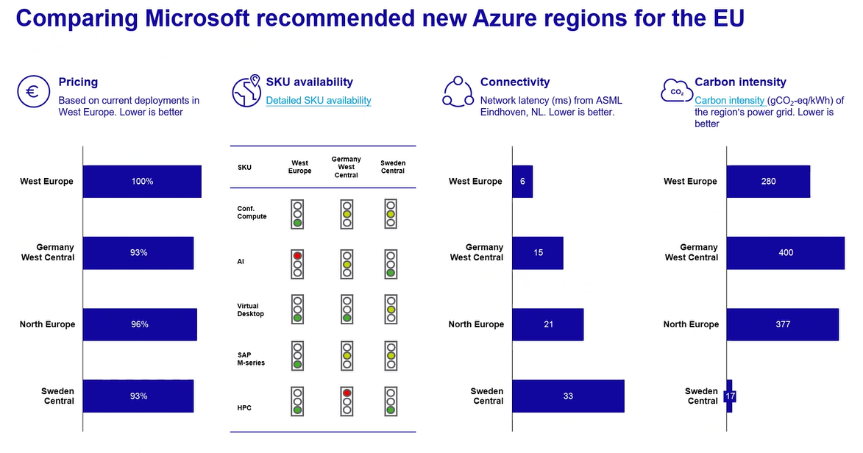
Azure EU extra region

Slide 6
Architecture decisions
Architecture Decision Records (ADRs) are stored in the Architecture Decision Log (ADL)
Architecture Decision Log (ADL)

Slide 7
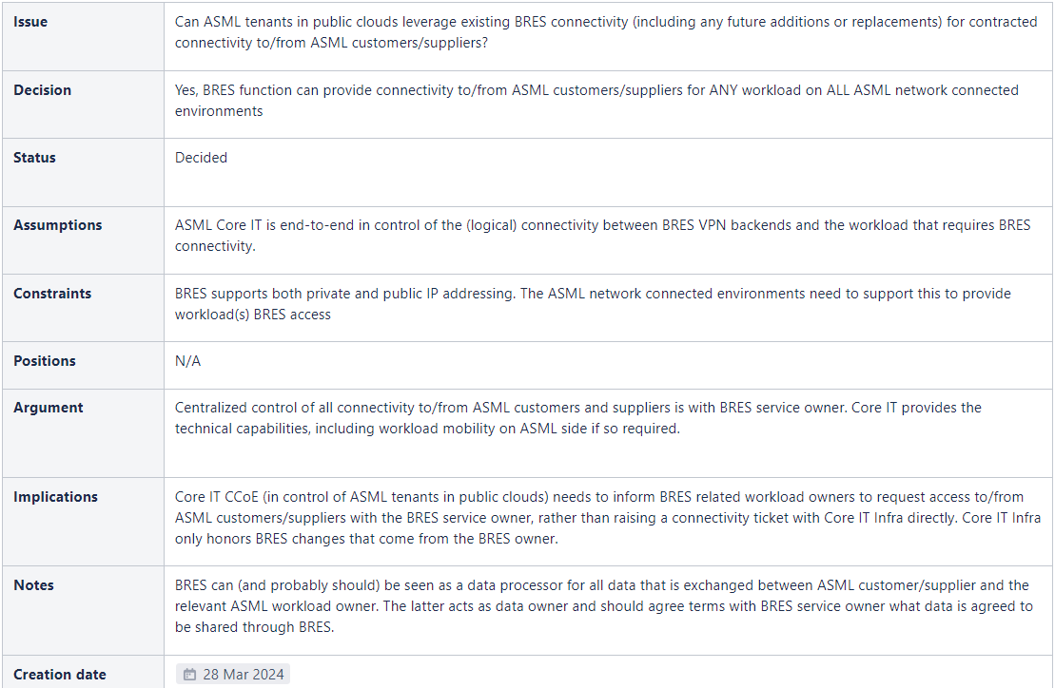
#0005 - BRES connectivity for ASML public cloud tenants

Slide 8
Technical Debt
Technical Debt is stored in Jira with label “TechnicalDebt”
Infra ART - Agile board - Jira Software Cloud - Core IT (atlassian.net)

Slide 9
Technical Debt
Administration of Technical Debt
Any Technical Debt needs to be registered in order to plan the pay-back of technical debt into the backlog of the Infra ART
The architecture competence has been working on creating a standard way of describing and registering technical debt within ASML Core IT.
Contributors: Tom van Sebille | Hans Tonneijk | Gert Boks | Ruud van den Meerakker | Erik Mijnsbergen

Slide 10
Technical debt | Introduction
What is Technical debt?
Value
Technical debt caused by shortcut
Target
Technical debt is the result of a conscious decision to choose a shortcut instead of the Target Architecture.
Shortcut above target
It includes postponed maintenance as well, like upgrades or refactors. These become Technical debt only after the time they should have been done (according to LCM policy)
Remaining work after a partial implementation is not technical debt
New or updated application functionalities (with upgrades/patches) do not cause technical debt in themselves
Rework
Shortcut
Taking the shortcut delivers some value very quickly but will lead do delay later. Rework is necessary before additional value can be delivered. There can be good reasons to follow this strategy.
As-is
Time
Value
Technical debt caused by delayed upgrade
Target
Maintenance & rework
Maintenance
Maintenance or upgrade can increase development speed but there is no time to do so.
As-is
Time

Slide 11
Technical debt | Sources
Target Architecture & Incremental System Architecture (ISA)
Deviating Solution design from ISA
Deviating ISA from Target Architecture
Technical debt occurs because solution design deviates from ISA.
Responsibility: DevOps team
Technical debt occurs if ISA deviates from Target Architecture, and solution is implemented according to ISA.
Responsibility: ART
Target Architecture / Vision / Principles
Target Architecture / Vision / Principles
ISA
ISA
Desired solution
Actual solution
Desired solution
Actual solution

Slide 12
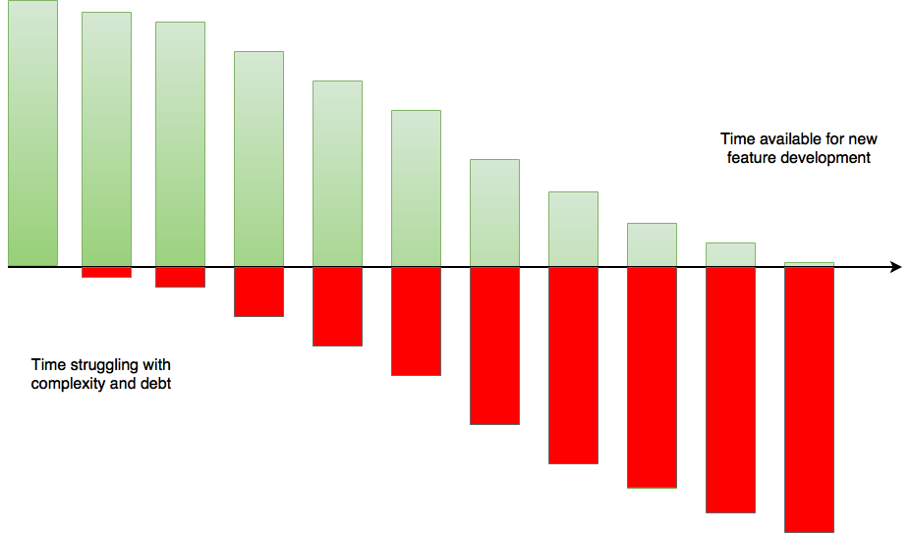
Technical debt | Impact and effect
Increasing costs and time-to-market
The impact of technical debt can be:
Additional work/loss of velocity in implementing user stories
Inability to implement certain required functionality
Avoidable risks (e.g., continuity risks, security risks)
Unpaid technical debt can accumulate “interest”, the problem gets bigger
Increasing interest payments
The cost & time-to-market for delivering the same “amount” of functionality can increase drastically over time

Slide 13
Technical Debt | Registration and follow-up
Maximize customer value – Minimize technical debt
Incurring technical debt is not necessarily a bad thing
Common practice Agile; avoid excessive work and/or unknown risks
There is no criteria when technical debt should be allowed or when it should be paid back
Technical debt MUST be registered correctly
Plan the pay-back of technical debt into the backlog
Usually this is rework, replacing the shortcut with the better solution, or performing the required upgrade
The reason is to avoid the cost, risk or limitations of the shortcut
Usually paying back the technical debt does not bring user functionality directly
It can also be remitted by changing the target architecture
"Sequence work in a way that maximizes customer value and minimizes technical debt"
Technical debt is registered as an issue (Feature / Story) with Labels-field “TechnicalDebt” (one word) in JIRA.​
Must contain impact in terms of costs/speed and risks
Must contain the effort to pay back the debt
Must be periodically re-evaluated to keep up-to-date
It should be booked by Product Owner (responsible) on the backlog​
Chief Product Owner is accountable for correct registration

Slide 14
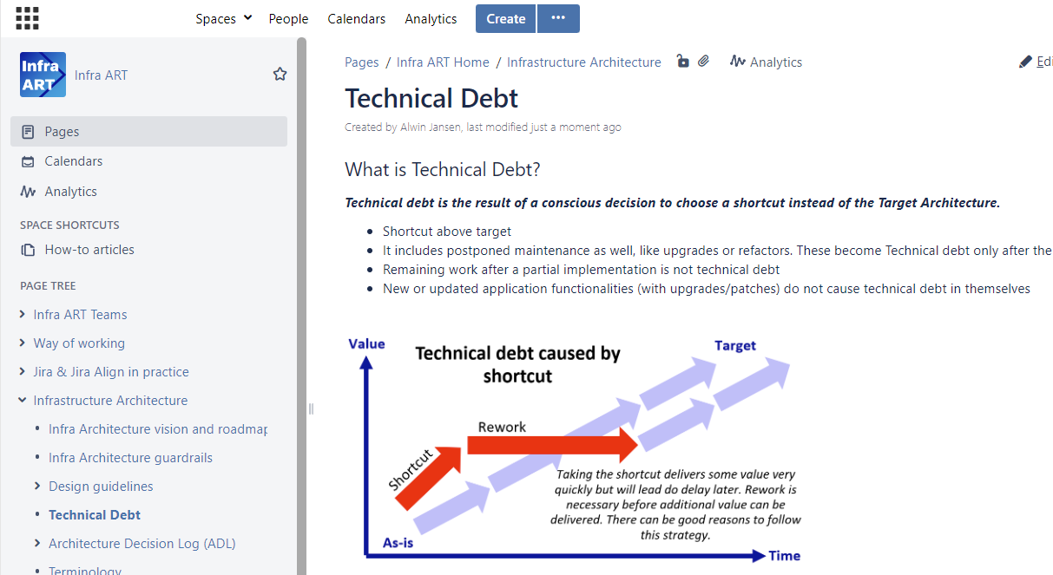
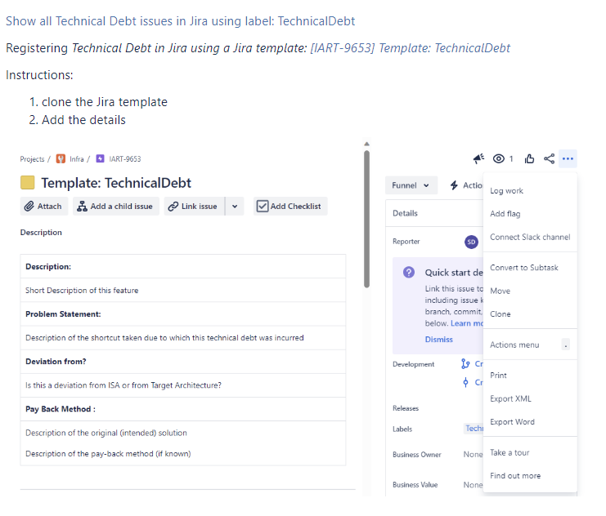
Technical Debt
Documentation on Architecture Wiki
Information from Slidedeck is stored on the Wiki with link to original deck on the Architecture Competence SharePoint.
It also includes:
Link to show all Technical Debt issues in Jira
Link to register Technical Debt including instructions

Slide 15
Architecture enabler Features & Stories

Slide 16
Enabler features and stories
Created
# | Name | Purpose | DRM topic | Created by
1 | Long-term solution IP session limitations | Develop solution to overcome IP session limitation | Insights and update on P2 Wilton | Jordi Schlooz
2 | Introduction of IPv6 | Investigate impact on implementing IPv6 | Insights and update on P2 Wilton | Jordi Schlooz
3 | Site Network validation |  | Insights and update on P2 Wilton | Jordi Schlooz

Slide 17
Enabler features and stories
Completed
# | Name | Purpose | DRM topic | Created by
1 | <Add any feature or story completed>
2
3

Slide 18
Solutions designs & demo’s

Slide 19
Solutions designs & demo’s
Overview
# | DRM topic | Lead Engineer
1 | Insights and update on P2 Wilton | Bogdan Radu
2 | Cisco CSP and ASR replacement | Bogdan Radu
3 | Intersight managed mode (IMM) | Anandraj TR
4 | VLAN MCP Issue | Anandraj TR
5 | P&T Storage grid | Vit Kokes
6 | Visibility, insights and operational enabler via Insights | William Kimandu
7 | Enable L2 forwarding functions in ACI | William Kimandu
8 | IPN building Capacity | William Kimandu

Slide 20
<DRM topic name>
Template – please copy slide
Lead engineer: <name>
Status: <In progress | closed>
Problem description
Preferred or selected solution
What should the decision accomplish?
Describe what we’re trying to accomplish by even bothering to make a decision
Description of the change
Reason behind this change (describe relevant facts and event that already happened)
High level intent behind the change
Solution option x
Describe the reasoning and approach
Based upon criteria, such as Strategic fit, Architecture Principles, functional fit, Technical, Security & Compliancy, Supplier, or Cost
Based on Pilot / Poc / Demo’s
Based upon standardization ambition
Based upon constraints from other functions
Risk (impact & probability) associated with the change
Solutions options
Next steps (in progress) | Done (when closed)
Solution option 1
Solution option 2
Describe the solution options.
Possibly clarify with solution design diagrams including PROs, CONs & constraints on a separate slide
Describe the next steps before a decision could be made
If the decision has been made what needs to be done or has been done?
Enabler feature(s) or stories(s) to be created or has been created?
Decision to be added to Architecture Decision Log (ADL) or has been added

Slide 21
Insight and update on P2 Wilton
Lead Engineer: Bogdan Radu
Status: Investigating long-term solution
Problem description
Preferred or selected solution
What should the decision accomplish?
Prevent NAT depletion on XL sites
Description of the change
Change NAT configuration from interface (single IP) to a pool in XL sites
Reason behind this change (describe relevant facts and event that already happened)
Recent P2 Incident in Wilton
Preferred solution is to move to NAT pool
Use already allocated public IP addresses
Already tested and functional
No architecture change, only SBB
Solutions options
Next steps (in progress) | Done (when closed)
Tunning of NAT/TCP timers
Move from interface NAT to NAT pool
Offloading NAT to a different device
Change in Wilton scheduled for April 28th

Slide 22
Cisco CSP and ASR replacement
Lead Engineer: Bogdan Radu
Status: In progress
Problem description
Preferred or selected solution
What should the decision accomplish?
Find replacement for ASR and CSP replacement
Description of the change
Lifecycle management
Reason behind this change (describe relevant facts and event that already happened)
ASR is end of sale. In China a replacement for ASR cannot be delivered, so a new platform is needed
CSP is end of sale. Also a replacement needs to be found
Hardware is ready, test plan is ready
For the ASR, the chosen replacement platform is Cisco Catalyst 8500 series
For the CSP, the chosen replacement platform is eCPU v8300 virtualization platform
Solutions options
Next steps (in progress) | Done (when closed)
For ASR, the replacement is Cisco Catalyst 8500 platform with different versions depending on t-shirt size
For CSP, the options are:
Physical router (Cisco 8200 or 8300)
eCPU v8300 virtualization platform
PoC Catalyst 8500
Manual upgrade
VManage upgrade
Load configuration templates
Test throughput (cannot test over 10G) - some challenges because of high amount of traffic
PoC eCPU v8300
Running vEdge
Running cEdge
Running vWLC
Running ISE PSN node (medium and higher didn't run on CSP)

Slide 23
Intersight Management Mode
Lead engineer: Anandraj TR
Status: closed
Problem description
Preferred or selected solution
What should the decision accomplish?
Management platform for M7 and new hardware for cisco compute platform.
Description of the change
New Management platform and will be way forward for all Cisco compute.
Reason behind this change (describe relevant facts and event that already happened)
Without this we can't adapt new hardware from Cisco.
High level intent behind the change
Enabling new capabilities in IMM
Solution option 1
Centralized management & config platform
Global policy
Provision of the Hardware from Central management
Reuse of the Policy.
POC need to planned to test the Use cases.
Solutions options
Next steps (in progress) | Done (when closed)
Solution option 1 – Design the IMM. Create the LLD and Build the M7 in IMM mode.
Describe the next steps before a decision could be made
If the decision has been made what needs to be done or has been done?
Taken the approval from Architect.
Design has been approved.
Working on the IMM mode LLD and will be delivered by PI24.2.S4

Slide 24
VLAN MCP issue
Lead engineer: Anandraj TR
Status: In Progress
Problem description
Preferred or selected solution
What should the decision accomplish?
The VLAN MCP issue is a big challenge in Operations for the Flexpods more than 2000 VLANs and 256 MCP per vPC
Description of the change
N9K has a limitation and this need to mitigated ASAP.
Reason behind this change (describe relevant facts and event that already happened)
VLANs configured or consumed morethan the limit.
Limitation with the current ACI Code
High level intent behind the change
Need to come up with solution which will solve the problem
Solution option 1
Work with Cisco to make the firmware available – GA.
Solution Option 2:
Have a white board session with all the stake holder and design a solution " Workload Centric "
Solutions options
Next steps (in progress) | Done (when closed)
Solution option 1 – Work on the Capacity and remove the unused VLANs. Accept the risk.
Solution 2 – Work with Cisco to make the started release as GA. Which has a limitation of 12000 VLANs and 2000 MCP per vPC.
Describe the next steps before a decision could be made
If the decision has been made what needs to be done or has been done?
Planned a Bi-weekly meeting with the respective stakeholders.
Need to think on broader vision on "Workload Centric "
Need to come up with proposal
Need to create a new EPIC for the same.

Slide 25
Visibility, insights and operational enabler via NDI
Lead engineer: William Kimandu
Status: In progress
Problem description
Preferred or selected solution
What should the decision accomplish?
Quicker resolution of issues Automated troubleshooting and root cause analysis.
Proactive prevention of issues - bug checks and upgrade assistance Proactive monitoring of anomalies and compliance against ASML rules
Proactive on resource utilization and capacity planning
Global view and insights from a single pane of glass for all of our global DC fabrics
Traffic analytics, operational efficiency and simplify day to day tasks
Security – prevention of issues
Description of the change
Deploy and implement Insight capability in our datacenters
Reason behind this change (describe relevant facts and event that already happened)
Not having visibility – hampers hand overs , capacity and shorten software upgrade cycles and delayed demand fulfillment.
High level intent behind the change
Enabling capability for DC services
Solution option 1
Reduce complexity introducing analytics and insights
Based upon criteria, such as Strategic fit, Architecture Principles, functional fit, Technical, Security & Compliancy, Supplier, or Cost
Comply to design SBB, security enforcement, ND insights has out of the box understanding of Cisco and support for DEVOPS via assurance and PCV (pre- and post –change validation)
Based on Pilot / Poc / Demo’s POC (NRW) and a Demo - (ART, DRM (pending Management)
Based upon standardization ambition Standardizations via compliance rules
Based upon constraints from other functions
Risk (impact & probability) associated with the change NO impact – NDI is not in the control plane or data plane of DC operations
Solutions options
Next steps (in progress) | Done (when closed)
Solution option 1 – Implement Nexus Dashboard Insights
Solution option 2 – Use inbuilt ACI tooling, continue with manual operations, disaggregated tooling, long demand fulfillment schedules, ineffectiveness and lack of agility
Describe the next steps before a decision could be made Demo for the all-relevant stakeholders – bottom – up GO ?NO GO moment – training – and handover to ops
If the decision has been made what needs to be done or has been done?
Enabler feature(s) or stories(s) to be created or has been created? SBB updates, ops handover, extension to other Datacenters; deployment models
Decision to be added to Architecture Decision Log (ADL) or has been added

Slide 26
Alwin Jansen
Veldhoven
System Architect Infra Art

